Slide 1
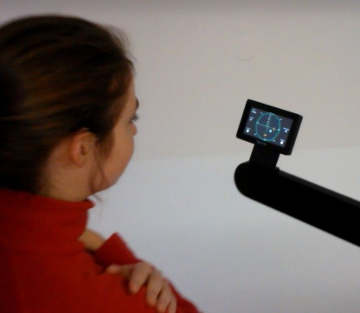
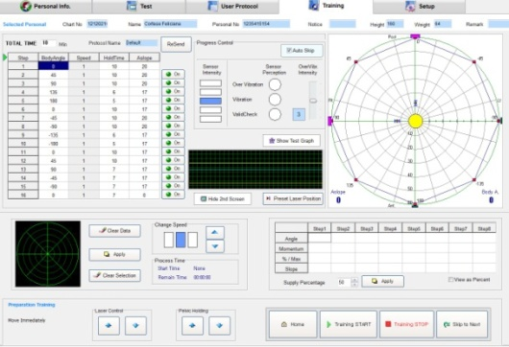
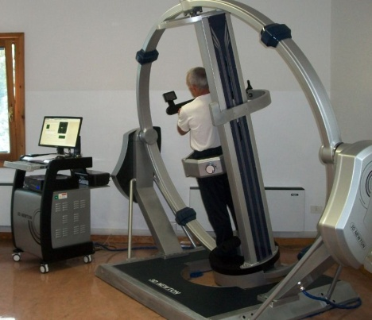
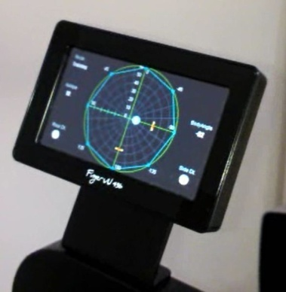
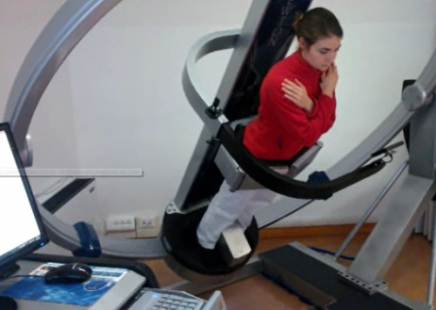
Postural Control by
3D Newton
Feliciana Cortese
Antonio Rizzetto
Unità Funzionale di Medicina Riabilitativa
Casa di Cura Privata Villa Margherita-Arcugnano-Vicenza

Slide 2
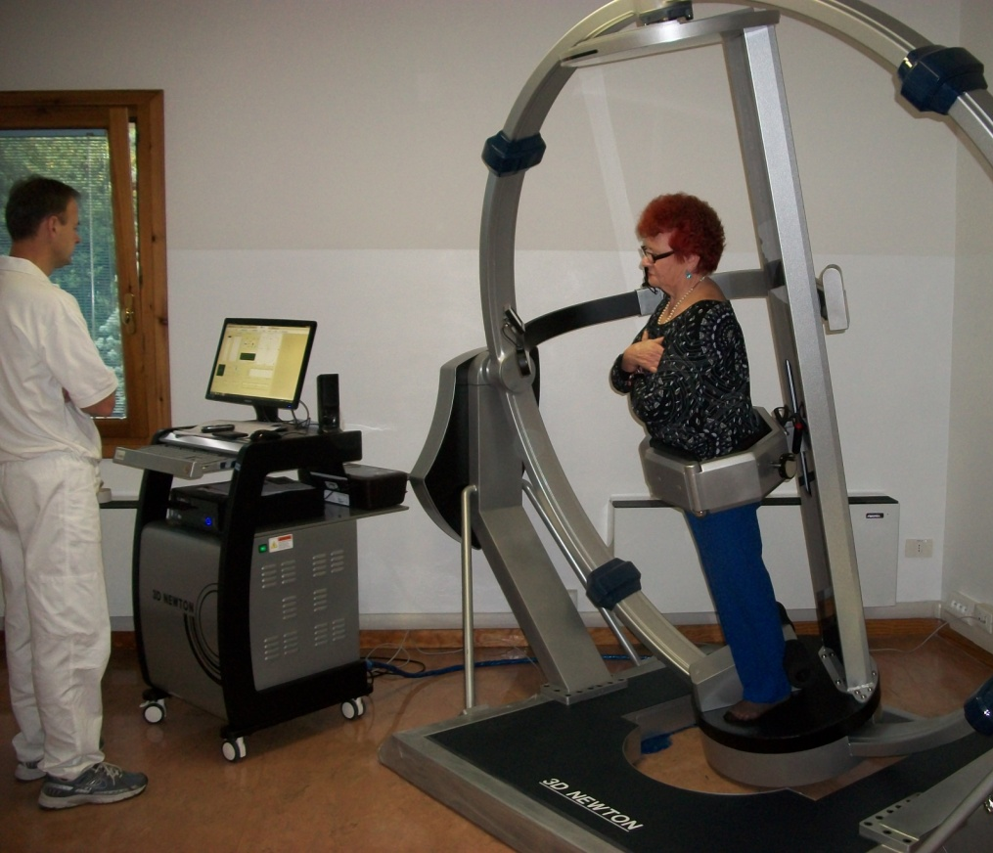
3D Newton has been designed for treatment of Low Back Pain disease due to instability of the spine
Lumbopelvic stability is influenced by trunk muscles (global muscles & local muscles).
Trunk instability could induce
low back pain.
Strengthening of lumbo-pelvic
muscle is important for not
only treating low back pain but
also preventing low back pain.

Slide 3
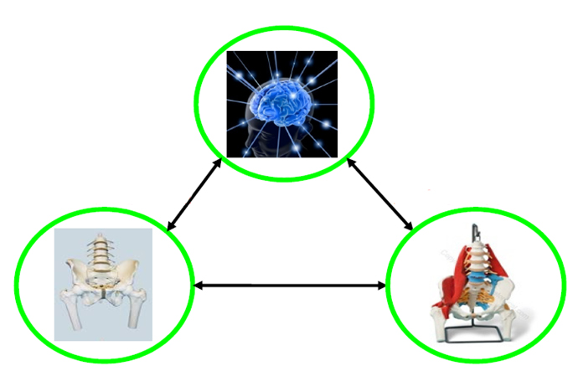
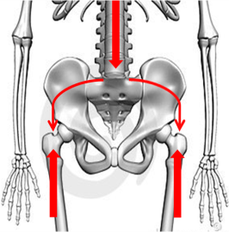
Spine stability depends on three subsystems (Panjabi, 1992)
Control subsystem (neural control)
Passive subsystem
(vertebras, facets,
disks, ligaments)
Active subsystem
(trunk-pelvis muscles)

Slide 4
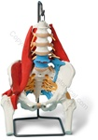
Active subsystem
Global mobilizer
Rectus abdominis
External oblique
abdominis (lateral fiber)
Erector spinae
Global stabilizer
Internal abdominal
oblique
External oblique
abdominis (medial fiber)
Local stabilizer
Transversus abdominis
Multifidus
Active subsystem provides segmental stability and produce
movement with stability (Gibbons & Comerford, 2001)
Strengthening of local & global muscles ⇒ Increase lumbo-pelvic
stability
Notes:
Global muscles은 기능에 따라 다시 mobilizer, stabilizer로 분리할 수 있음
Local stabilizer: segmental stability
Global stabilizer: eccentrically to control range of motion
produce movement with stability
Global mobility: 움직임에 주로 관여
load or high speed movement 시 eccentric contraction을 통해 stability 제공
4

Slide 5
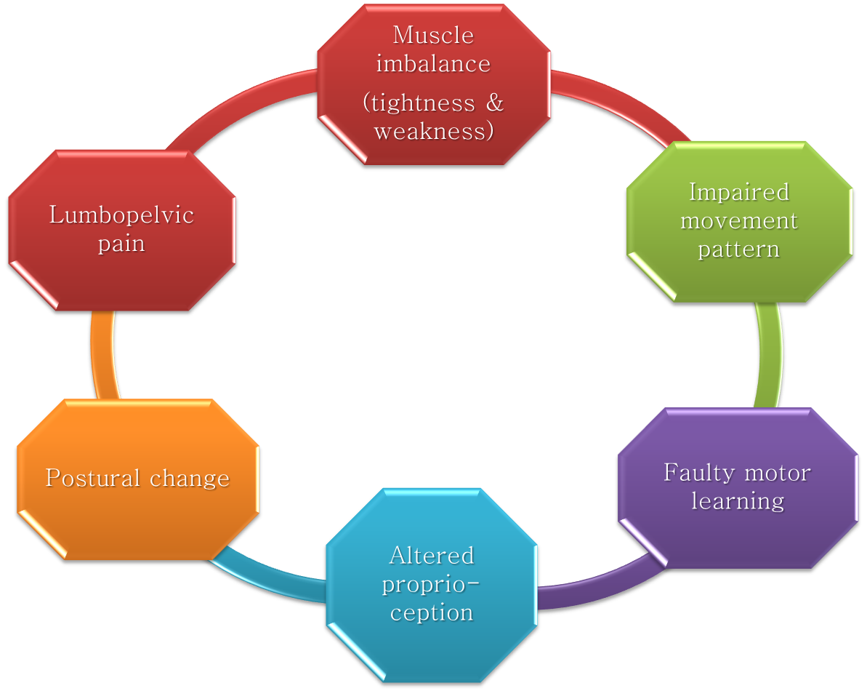
Musculoskeletal
pain cycle
(Lund et al.,1991)
Notes:
근육의 약화가 일어나게 되면 다음과 같은 변화가 나타나 stability에도 영향을 주게 되어 통증을 야기할 수 있다.
5

Slide 6
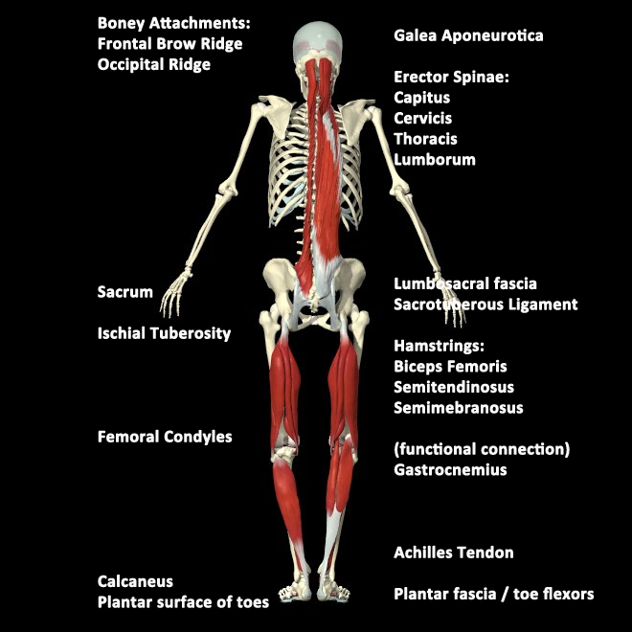
Importance of anti-gravity muscles
Mainly: extensors of the ankle, knees, hips, and back.
By their tone resist the constant pull of gravity in the maintenance of normal posture
Antigravity muscles are activated
when gravity force is applied as a
resistance
Multifidus is more activated than
iliocostalis lumborum during trunk
holding (Ng et al., 1997)
EMG activity of trunk muscles
increase with increasing trunk tilt
angle (Anders et al., 2008)
Notes:
those muscles, mainly extensors of the knees, hips, and back, that by their tone resist the constant pull of gravity in the maintenance of normal posture
6

Slide 7
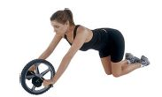
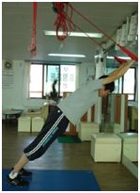
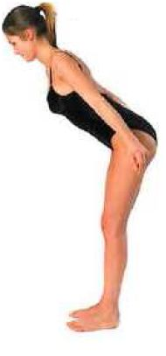
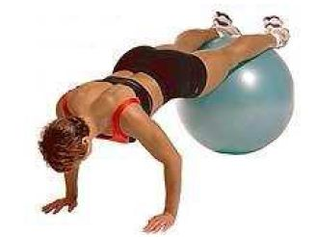
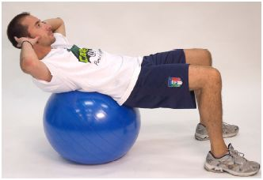
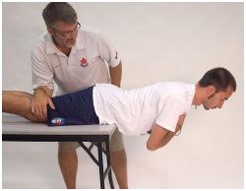
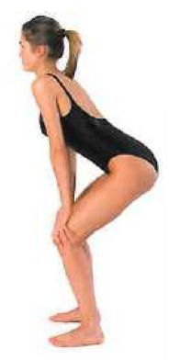
Devices for trunk instability treatment
Devices with unstable conditions
High cost-effectiveness & convenient application but impractical for elderly
or with other disabilities persons.
Could not acquire quantitative outcomes of exercises.
Notes:
슬링, 불안정한 지지면을 이용한 운동
7

Slide 8
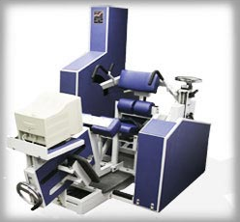
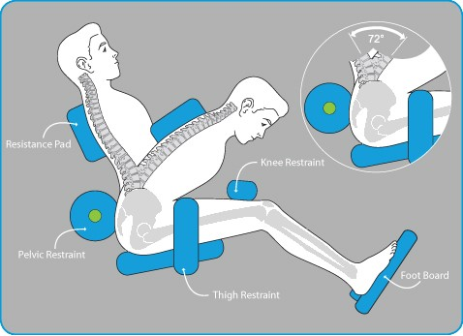
Strengthening of back muscles
Difficult to strengthen abdominal muscles effectively.
Notes:
메덱스 이름을 넣어도 될지 몰라서 일단 이름은 이렇게 적었습니다.
8

Slide 9
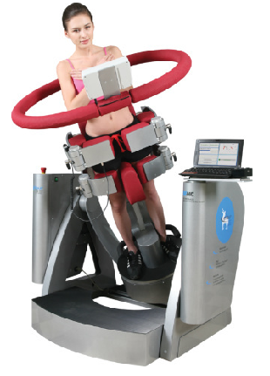
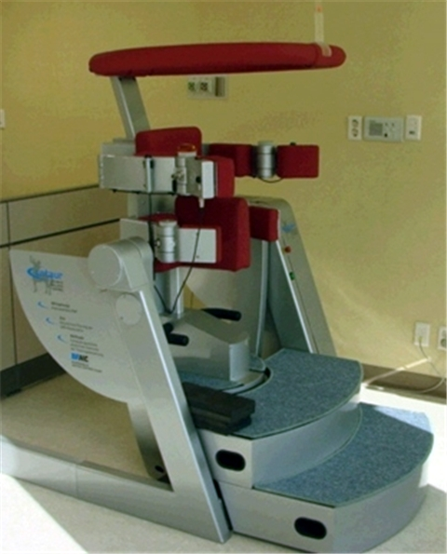
3-D CENTAUR
Recently, strengthening of trunk muscles using gravity force is suggested as a new exercise protocol for low back patients.
However, this machine do not provide biofeedback for correcting postural alignment.

Slide 10
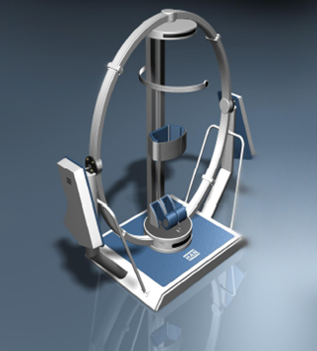
3-D NEWTON
Gravity force
Biofeedback
Multidirection
3-D NEWTON could use gravity force as a resistance.
Multidirectional gravity force.
Strengthening of back muscles as well as trunk muscles.

Slide 11
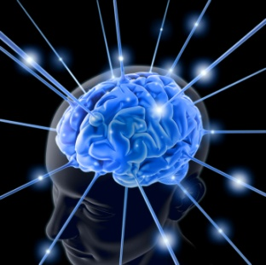
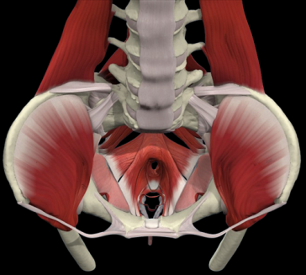
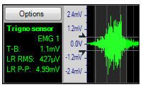
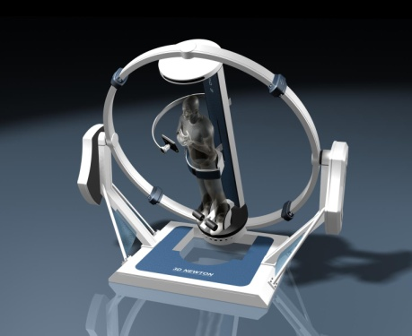
C N S
Effectors
Motor
command
Biofeedback loop
Biofeedback
Action
Assessment
of outcome
Outcome
Exercise
Notes:
CNS가 근육과 같은 작용기에 운동 명령을 내림
운동을 하는 동안 근육이 작용함
운동 결과에 대한 측정을 실시함
측정결과를 실시간으로 biofeedback을 통해 제공함
Biofeedback 정보에 따른 새로운 운동명령을 근육에 내림
11

Slide 12
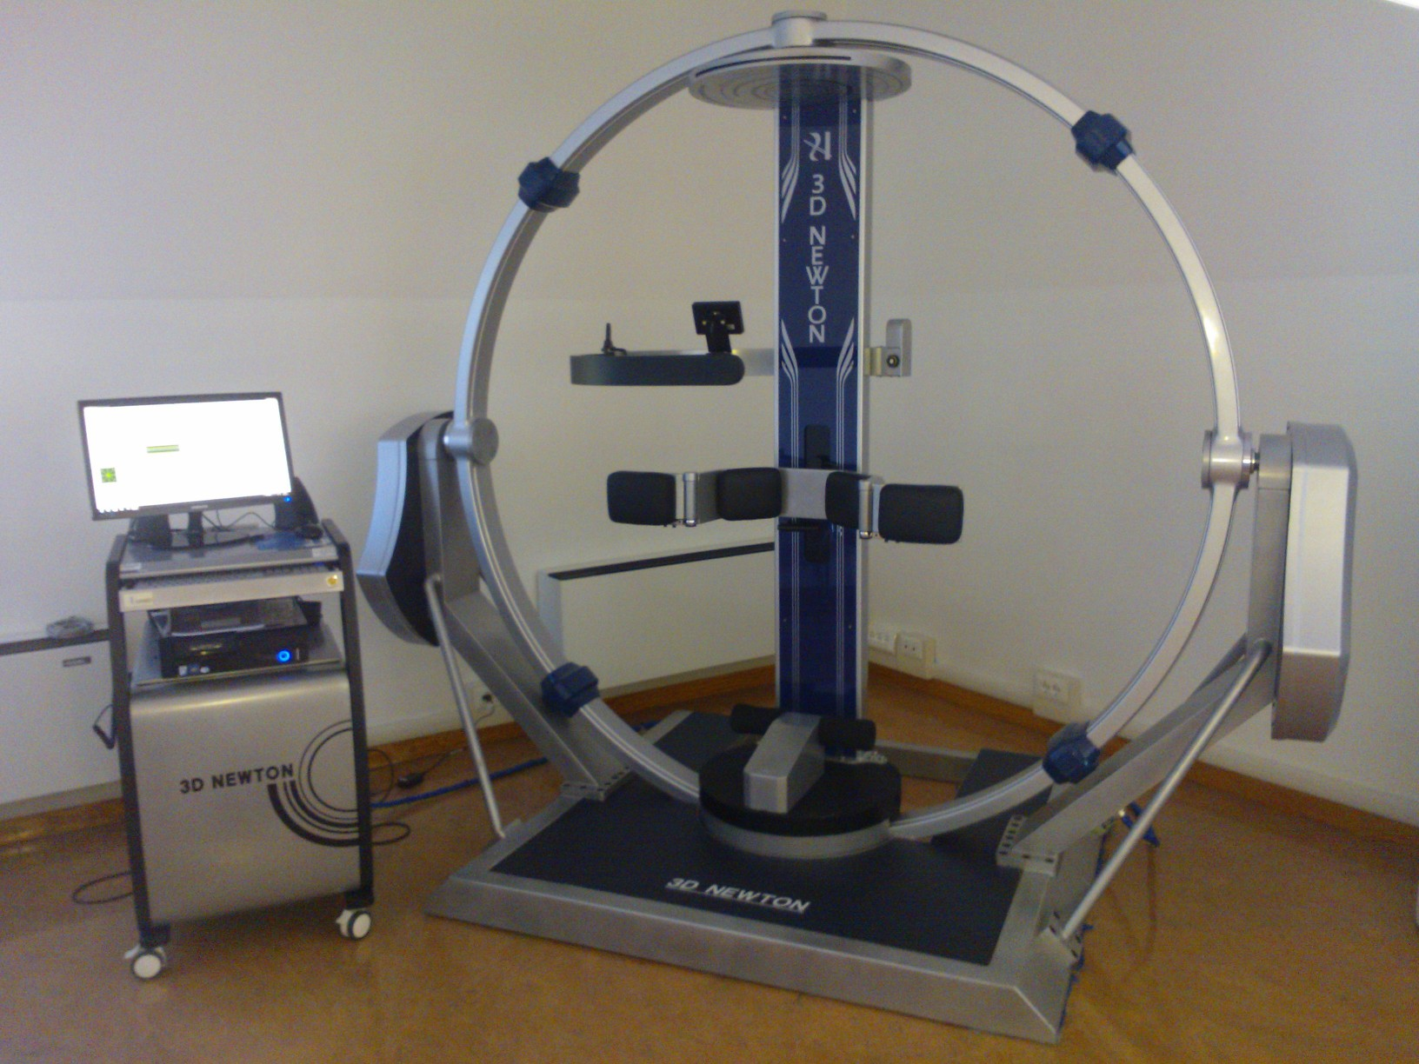
3-D NEWTON
Notes:
-쉽게 사용할 수 있는 사용자에 친밀한
-요부에 안정성을 증가시킬 수 있는 기구
-시각적 바이오피드백을 이용해서 자세에 정렬을 스스로 모니터링하는 셀프코칭 기능이 있다.
-Emg를 이용해서 객관적인 결과를 획득할 수 있다.
12

Slide 13
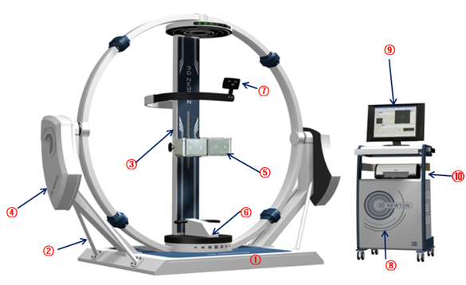
Struttura di base
Sostegno inclinazione circolare
Sostegno corpo con pulsante di emergenza
Cilindro motore e cover
Fissaggio pelvi regolabile in altezza
Fissaggio caviglia
Sensore e mini-monitor a cui sono collegati allarmi sonoro e visivo
Control box con pulsante accensione apparecchiatura e lettore computer
Monitor per utilizzo software
Stampante

Slide 14
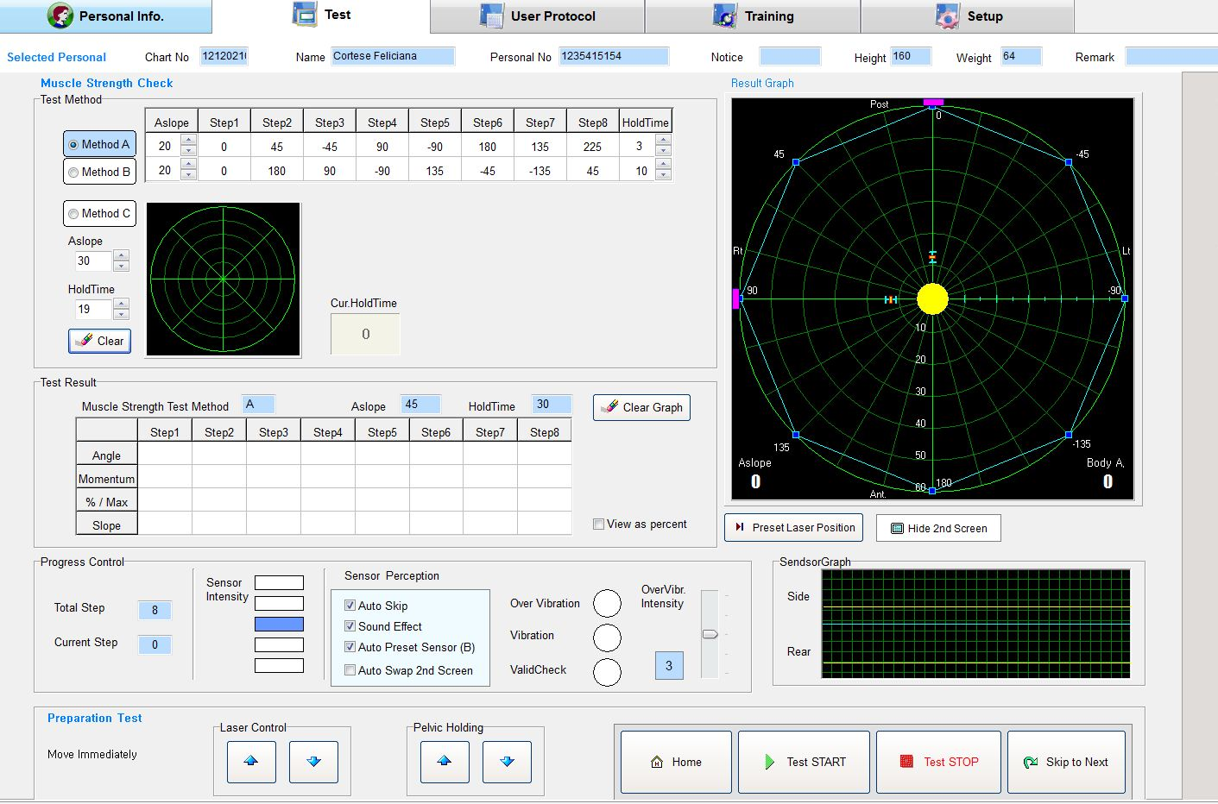

Slide 15
Spiegazione funzionamento?

Slide 16
Properties of 3d Newton:
Goals:
ensure stability ("core stability") during the load transfer and the
execution of precise movements
achieve improvements in balance, proprioception, coordination and
muscle synergies in all functional requirements of the activities of daily
living
develop: - the most effective recruitment pattern
- improved motor unit synchronization with faster activation of
nerve
- lowering inhibitors reflexes threshold
Mode:
personalized postural control’s exercise able to stimulate neuromuscular system through a multidirectional destabilizing action ("instability training'') aided by visual and audio feedback.

Slide 17
Properties of 3d Newton:
Advantages:
Equipment able to stimulate and strengthen the trunk’s deep muscles
by a prolonged isometric exercise
Postural control’s facilitation due to the visual and audio feedback.
Customized training after tests
Users safety during training
Versatility in setting all training parameters (rotation and tilt degrees),
Possibility to modify any software parameter in a rapid and intuitive
way during tests and training exercise
Work in standard conditions allowing therapy continuity and
statistical data’s production.

Slide 18
Treatment by means of 3D Newton
Test A: defines the direction and the inclination in which the body becomes unstable.
Test B: defines the time after which the patient's body becomes unstable (failure in maintaining inclination).
Both tests are performed with visual display turned off or with closed eyes.
Tests indirectly indicate weak muscle groups and consequently provides on planning a customized training program.
Training: is developed in multiple sessions with gradual increase of difficulty:
Tilt’s increase, rotation speed’s increase, single session time’s increase, visual feedback and sound presence or absence.
Repeat Test A and B to check results

Slide 20
Most of the patients in our department are affected by neurological diseases, in particular stroke and Parkinson's desease. We know that in these conditions there is always an alteration of postural mechanisms in feddback and feedforward. Both are important in static and dynamic conditions.
Looking at the 3d we decided to exploit its properties to stimulate the postural mechanisms of patients with these diseases

Slide 21
Parkinson’s desease treatment experience
No. 19 patients (14 males, 5 females)
Age: 56-80
Diagnosis: Parkinson's disease (5 years old average)
Evaluation:
Clinical history
Functional pathological conditions (camptocormia, freezing, postural instability)
Tinetti balance scale evaluation (pre-post)
postural changes
Standing
Walking
3D test (pre-post)
Exclusion criteria:
Cognitive deficits
Important tremor / dyskinesia
Camptocormia

Slide 22
Considerations
All tested subjects have completed the initial assessment, final tests and the rehabilitation training
There were no clinical adverse events
The device stimulates postural mechanisms for feedback (test) and feedforward (training)
In this study we have found best test results at the end of training confirmed by patients in their activities of daily living. We need more data to confirm this results and compare with other study groups.

Slide 23
Stroke desease treatment experience
 |  |  |  | Barthel |  | FIM |  | Motricity Index |  |  |  | Trunk C.T.
 |  |  |  | adm. | disc. | adm. | disc. | adm. |  | disc. |  | adm. | disc.
 |  | age |  |  |  |  |  | arm | leg | arm | leg
1 | M | 39 | emiparesi dx | 60 | 100 | 116 | 125 | 84 | 76 | 100 | 100 | 100 | 100
2 | M | 76 | emiparesi dx | 60 | 95 | 116 | 119 | 100 | 76 | 100 | 84 | 100 | 100
3 | F | 57 | emiparesi sx-afasia | 55 | 100 | 77 | 125 | 48 | 58 | 100 | 100 | 100 | 100
4 | M | 54 | emiparesi sx-disatria | 50 | 90 | 96 | 117 | 76 | 92 | 93 | 100 | 100 | 100
5 | F | 69 | emiplegia dx-afasia | 40 | 90 | 64 | 111 | 55 | 75 | 93 | 100 | 74 | 100
6 | M | 67 | emiparesi dx-afasia | 45 | 80 | 66 | 110 | 34 | 84 | 88 | 100 | 100 | 100

Slide 24
